Slide 1
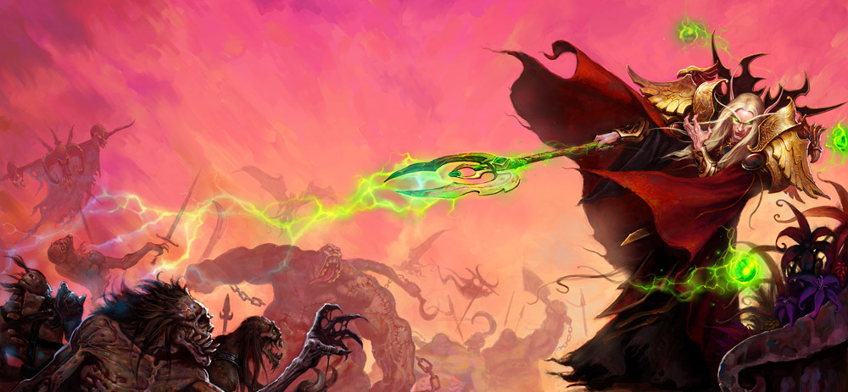
GA 4401 – Advanced Game Prototyping
http://www.gamasutra.com/view/feature/130848/how_to_prototype_a_game_in_under_7_.php
Week 6
Juicy Gameplay, and rapid prototyping

Slide 2
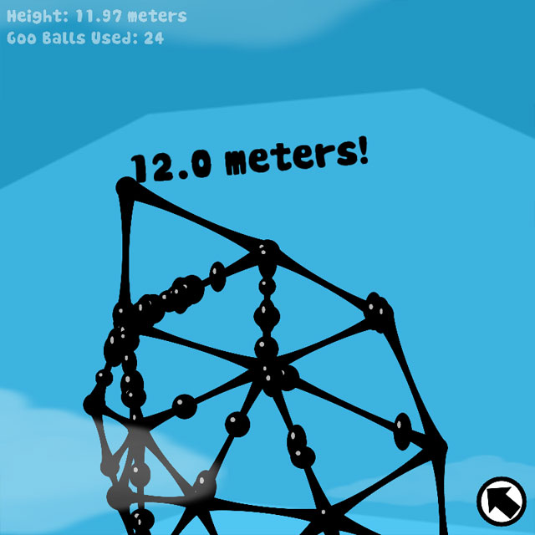
Tower of Goo

Slide 3
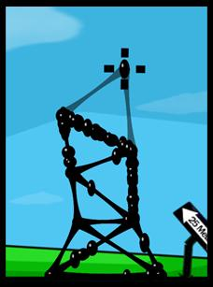
Setup: Rapid is a State of Mind
"Tower of Goo" was downloaded over 100,000 times within months of hitting the net.

Slide 4
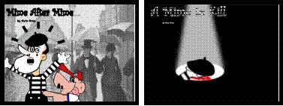
Embrace the Possibility of Failure - it Encourages Creative Risk Taking
"Mime After Mine" and "A Mime to Kill" - warmly embracing failure.

Slide 5
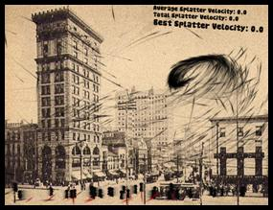
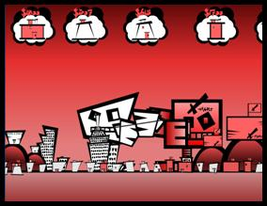
Enforce Short Development Cycles (More Time != More Quality)
Attack of the Killer Swarm” (left) took just a day to throw together and surprisingly became one of the highest rated games of the project. “Suburban Brawl” (right) received an extra week of love but became so convoluted it probably would have been more fun without the addition of giant killer robots – which wasted both cities and time alike.

Slide 6
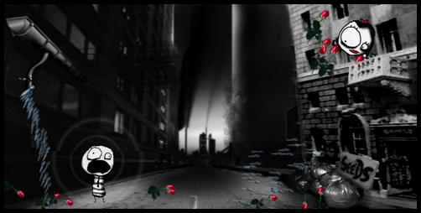
Constrain Creativity to Make You Want it Even More
“Gravity Head” – use your gravity-powered head to grow and deliver.

Slide 7
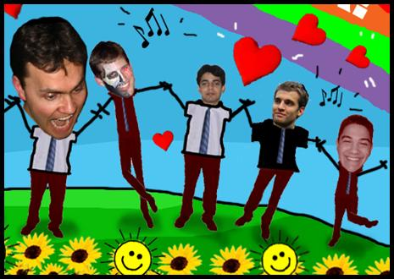
Gather a Kickass Team and an Objective Advisor – Mindset is as Important as Talent
“Our team, Experimental Friends 4 Ever!

Slide 8
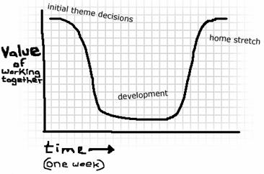
Develop in Parallel for Maximum Splatter

Slide 9
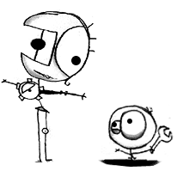
Design: Creativity and the Myth of Brainstorming

Slide 10
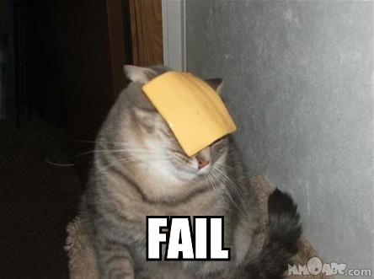
Formal Brainstorming Has a 0% Success Rate

Slide 11
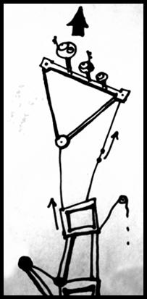
Gather Concept Art and Music to Create an Emotional Target
Tango music and little men climbing higher and higher...
http://www.youtube.com/watch?v=RUAPf_ccobc

Slide 12
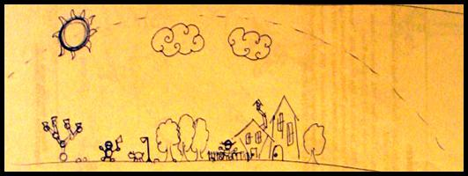
Simulate in Your Head – Pre-Prototype the Prototype
An early paper prototype for "On a Rainy Day" - helpful while simulating in your head.

Slide 13
Development: Nobody Knows How You Made it, and Nobody Cares

Slide 14
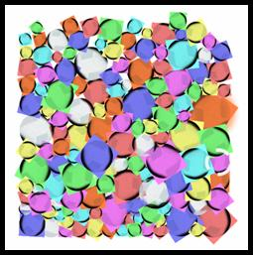
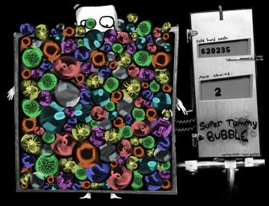
Build the Toy First
"Super Tummy Bubble" - Toy (left) vs. Final Prototype (right).

Slide 15
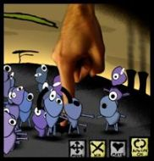
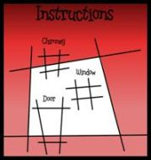
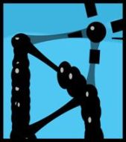
If You Can Get Away With it, Fake it
"Darwin Hill," "Suburban Brawl," "Tower of Goo" - all faked, and nobody noticed. Shhh!

Slide 16
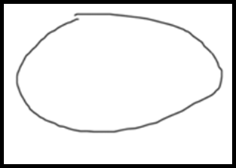
Cut Your Losses and "Learn When to Shoot Your Baby in the Crib"
"Matt's Potato" - bask in its glory.

Slide 17
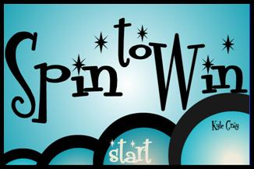
Heavy Theming Will Not Salvage Bad Design (or "You Can't Polish a Turd")
"Spin to Win" - all dressed up with nowhere to go.

Slide 18

But Overall Aesthetic Matters! Apply a Healthy Spread of Art, Sound, and Music
An unrealeased prototype - art doesn't have to be complicated to feel compositionally solid

Slide 19
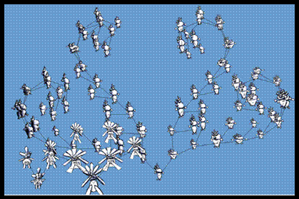
Nobody Cares About Your Great Engineering
"Evolution Trees" - all that technology doesn't add up to fun.

Slide 20
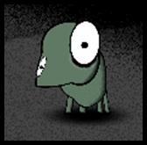
General Gameplay: Sensual Lessons in Juicy Fun

Slide 21
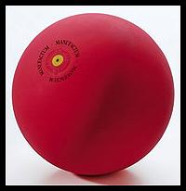
Complexity is Not Necessary for Fun
A rubber ball. Watch out, 3D technology!

Slide 22
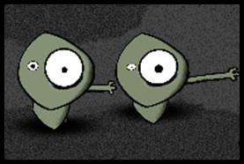
Create a Sense of Ownership to Keep 'em Crawling Back for More
"Darwin Hill" - everyone unique in their own special way.

Slide 23
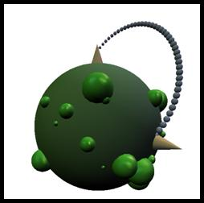
"Experimental" Does Not Mean "Complex"
"Spaceball Munch" - How can we know?!

Slide 24
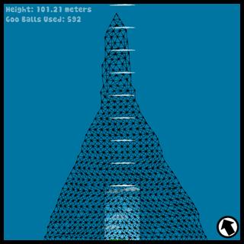
Build Toward a Well Defined Goal
"Tower of Goo" - building toward a goal... and beyond!

Slide 25
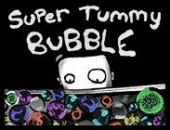

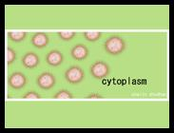
Make it Juicy!
Juice feels great! You can't keep your hands out of it.

Slide 26
More Juice!
http://grapefrukt.com/f/games/juicy-breakout/
http://www.youtube.com/watch?v=Fy0aCDmgnxg

